Slide 1


SAPTHAGIRI COLLEGE OF ENGINEERING
(Affiliated to Visvesvaraya Technological University, Belagavi& Approved by AICTE, New Delhi)
Department of Computer Science & Engineering
Final Project Review
Presentation
on
Heart Disease Prediction Using Novel
Quine McCluskey Binary Classifier
Presented by:
Name
Preetham S G
Santhosh D
Shravan L
Vivan Kushal Heneger
USN
1SG20CS082
1SG20CS094
1SG20CS100
1SG20CS114
Under the guidance of
Prof. SHWETHA K
Assistant Professor,
Dept. of C.S.E., S.C.E.
2023-2024

Slide 2
CONTENTS
Abstract
Introduction
Problem statement
Literature survey
Overall system architecture
Methodology
Modules description
Algorithms Used
Flow diagrams
Results
Conclusion

Slide 3
ABSTRACT
Improved diagnosis of cardiovascular disease and detection of high risk patients enabled by developing and evaluating an ensemble machine learning approach using logistic regression, decision trees, random forest, KNN, Naive Bayes, SVM and neural network models combined in a Quine McCluskey binary classification ensemble.

Slide 4
INTRODUCTION
The term ‘‘Heart Disease’’ (HD) is used to refer to a variety of pathological disorders that have an impact on the heart and blood vessels. It encompasses a variety of heart-related conditions, including but not limited to vascular diseases and disturbances in heart rhythm.

Slide 5
Problem statement
To design and develop the Heart disease prediction using quine mccluskey binary classifier.

Slide 6
Literature Review
Sl. No. | Title | Author | Year | Contributions & Drawbacks
1 | Effective Heart Disease Prediction Using Hybrid Machine Learning Techniques | C. G. D. S. E. Silva | 2019 | Contribution: It improving the accuracy in the prediction of cardiovascular disease. Drawbacks: It consume more time to execute. It is suitable only for binary classification, i.e cannot classify stages of heart disease
2 | HDPM: An Effective Heart Disease Prediction Model for a Clinical Decision Support System | T. Hauer | 2020 | Contribution: It improving the accuracy up to 98% in the prediction of cardiovascular disease. Drawbacks: It is suitable only for binary classification, i.e cannot classify stages of heart disease.

Slide 7
Sl. No. | Title | Author | Year | Contributions & Drawbacks
3 | Efficient Medical Diagnosis of Human Heart Diseases Using Machine Learning Techniques With and Without GridSearchCV | P. Ghosh, S. Azam and M. Jonkman, A. Karim | 2022 | Contribution: It is to develop a unique model-creation technique for solving real-world problems. Drawbacks: It is suitable only for binary classification, i.e cannot classify stages of heart disease.
4 | An Efficient Prediction Method for Coronary Heart Disease Risk Based on Two Deep Neural Networks Trained on Well-Ordered Training Datasets | S. Bashir | 2022 | Contribution: It is giving 90%, Efficient Drawbacks: •It is suitable only for binary classification, i.e cannot classify stages of heart disease.

Slide 8
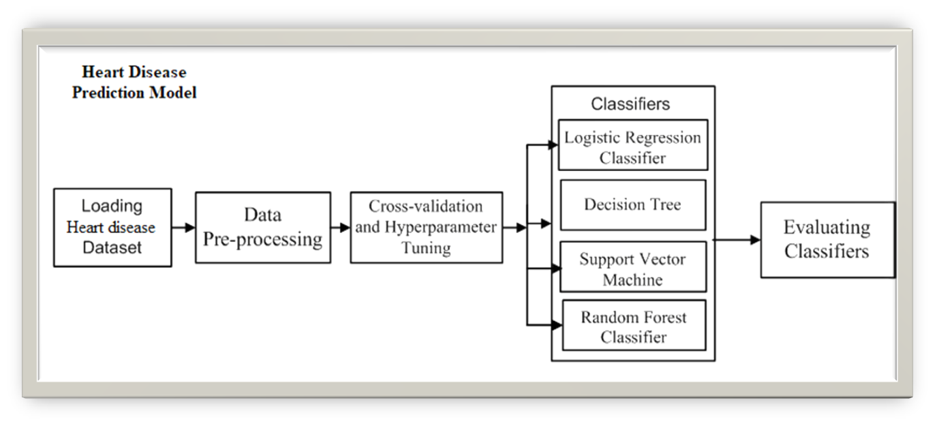
System Architecture

Slide 9
METHODOLOGY
In this project, a new ensemble Quine McCluskey Binary Classifier (QMBC) technique for identifying patients diagnosed with some form of heart disease and those who are not diagnosed.
The QMBC model utilizes an ensemble of seven models, including logistic regression, decision tree, random forest, K-nearest neighbour, naive bayes, support vector machine, and performs exceptionally well on multiclass class datasets.

Slide 10
MODULES
  DATA COLLECTION
  DATASET PREPROCESSING
  FEATURE EXTRACTION
  BUILDING ML MODULES
  PERFORMANCE EVAULATION

Slide 11
MODULES-DATA COLLECTION
This project utilizes a benchmark dataset that are publicly available in open repository. Several ongoing research studies utilize the Cleveland dataset from the University of California (UCI) as a standard to predict coronary heart disease.

Slide 12
MODULES-DATA PREPROCESSING
To ensure optimal performance and accuracy in ML, preprocessing is a crucial step that involves cleaning and preparing data before it is fed into a model for training.

Slide 13
MODULES-FEATURE EXTRACTION
FS is a critical process in ML that involves selecting the most relevant and informative features from a dataset to enhance a model’s performance.

Slide 14
BUILDING OF ML MODELS
This developing relationship between ML and cardiology has the potential to improve modern techniques for prediction and move the field closer to more accurate and reliable cardiovascular risk assessment.

Slide 15
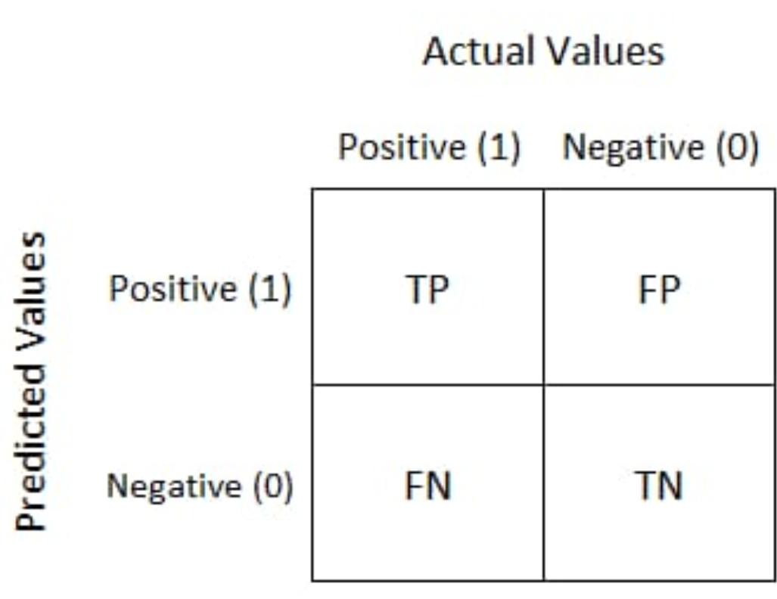
PERFORMANCE EVALUATION
To evaluate the performance of all models and proposed methodologies in this work, a confusion matrix is utilized. It provides an efficient and effective means of quantifying a model’s accuracy, precision, specificity, recall, and f1-score.

Slide 16
ALGORITHMS
  Logistic Regression
  Decision Tree
  Random Forest
  Navie Bayes
  Support Vector Machine
  KNN
  Voting Classifier
  QMBC.

Slide 17
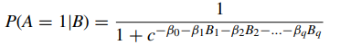
LOGISTIC REGRESSION
A logistic function is used in a LR model, which is a statistical method for modeling binary dependent variables. Classification problems commonly make use of LR.

Slide 18
DECISION TREE
A versatile technique is the DT model, which employs a set of decision rules defined by branches and attributes represented by nodes, each of which is a leaf node expressing a class label. It may be used for problems involving classification and regression.

Slide 19
RANDOM FOREST
It is an ensemble approach that combines different decision trees to enhance performance and reduce overfitting. The model functions by building several decision trees on various random subsets of data and then combining all of the trees predictions. It may be applied to both classification and regression problems.

Slide 20
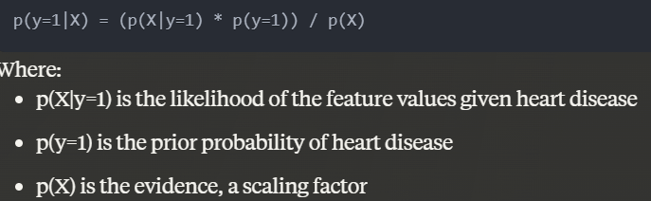
NAIVE BAYES
A probabilistic algorithm that calculates the probability of each class based on the input features is known as Naive Bayes. It is commonly used for text classification and other high-dimensional datasets.

Slide 21
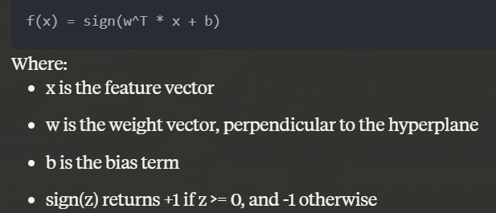
SVM
SVM is a technique that divides data into groups using a hyperplane in a high-dimensional environment. Given that it works well for both linear and non-linear classification tasks, SVM is a versatile ML technique.

Slide 22
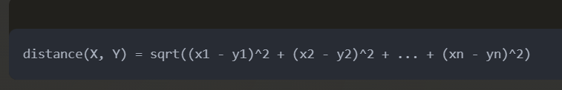
KNN
An approach for non-parametric ML that forecasts the result based on the training set’s KNN. It is a versatile algorithm that can be used for both regression and classification tasks. The number of nearest neighbors in a KNN used to create predictions for a new observation is represented by the value of k.

Slide 23
QUINE McCluskey BINARY CLASSIFIER (QMBC)
The Quine McCluskey method is an algorithmic approach to minimize the number of terms in a boolean expression. It is a two-step process that involves finding all the prime implicants and then grouping them to obtain a minimal boolean expression.

Slide 24
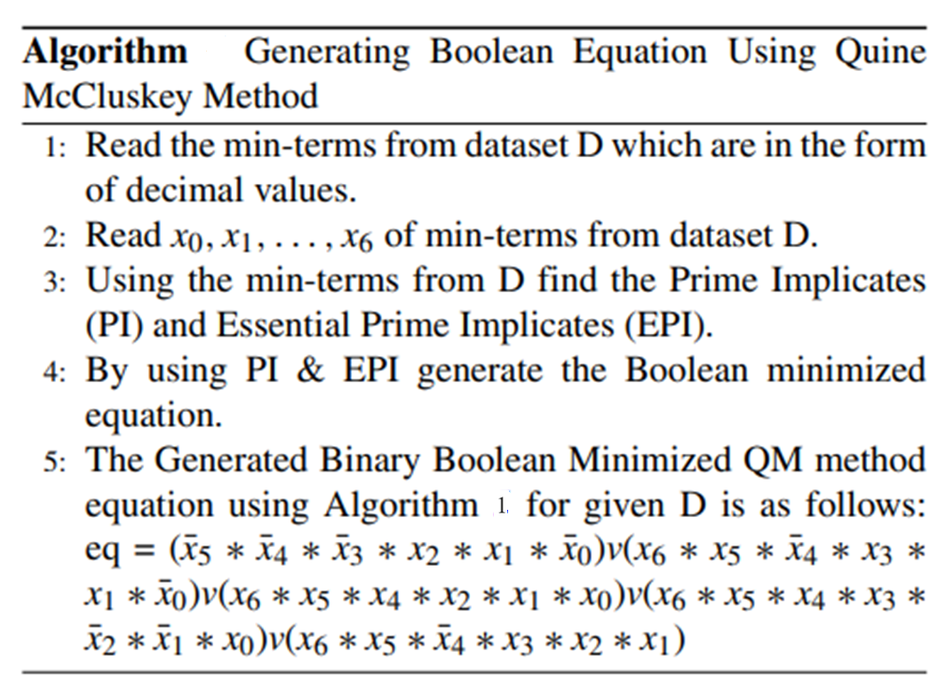
Generating Boolean Equation Using Quine McCluskey Method-ALGORITHM

Slide 25
VOTING CLASSIFIER
It is a method of ensemble learning that combines the results of various independent models to produce a single final prediction. It is a straightforward but efficient strategy that can raise the model’s overall effectiveness.

Slide 26
Data Flow Diagram-Level-0
0.1
Efficient classification of heart disease using Machine Learning Algorithm
Input data from heart patients
Result
Trained Data
Level: 0 describes the overall process of the project. We are input data from heart patients and trained data as input. By using the Machine learning algorithm it will efficiently classify the heart disease.

Slide 27
Data Flow Diagram-Level-1
1.1
Preprocess
1.2
Extract Features
Heart dataset
Features
Level: 1 describes the first step process of the project. We are passing heart dataset as input. System will read and preprocess the data and extract the most relevant features.

Slide 28
Data Flow Diagram-Level-2
2.1
Read the features
Features
2.2
Machine learning algorithm
2.1
Read data
Trained Data
2.3
Heart disease?
exit
NO
YES
Predict stage
Level: 2 describes the final step process of the project. We are passing extracted features from level 1 and trained data as input. System will read features and load the trained model to predict heart disease using machine learning algorithm.

Slide 29


RESULTS-GUI

Slide 30
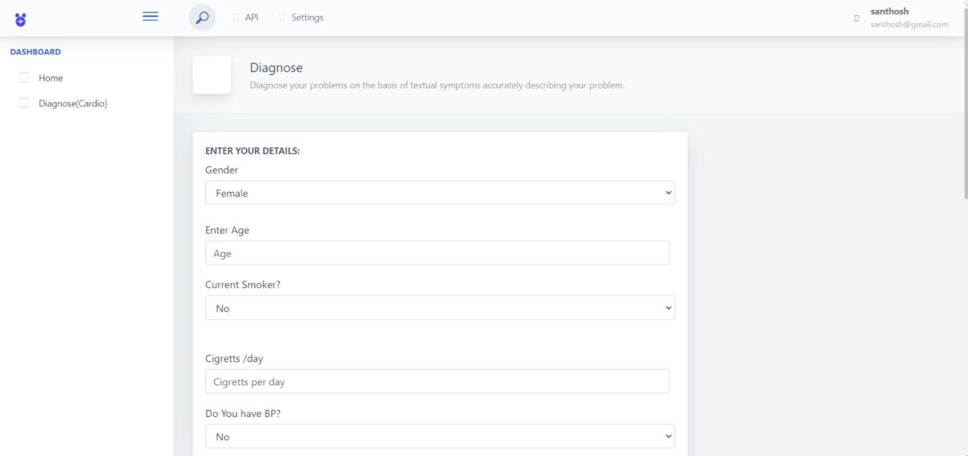
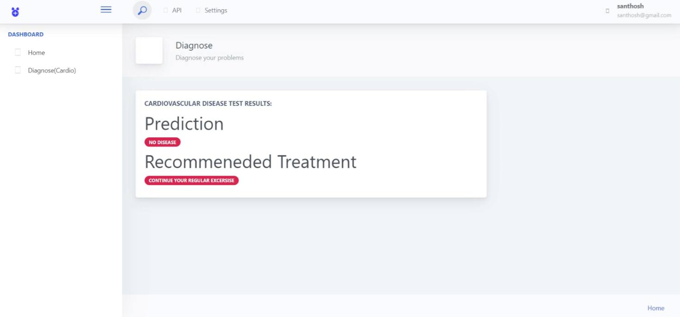
Results

Slide 31
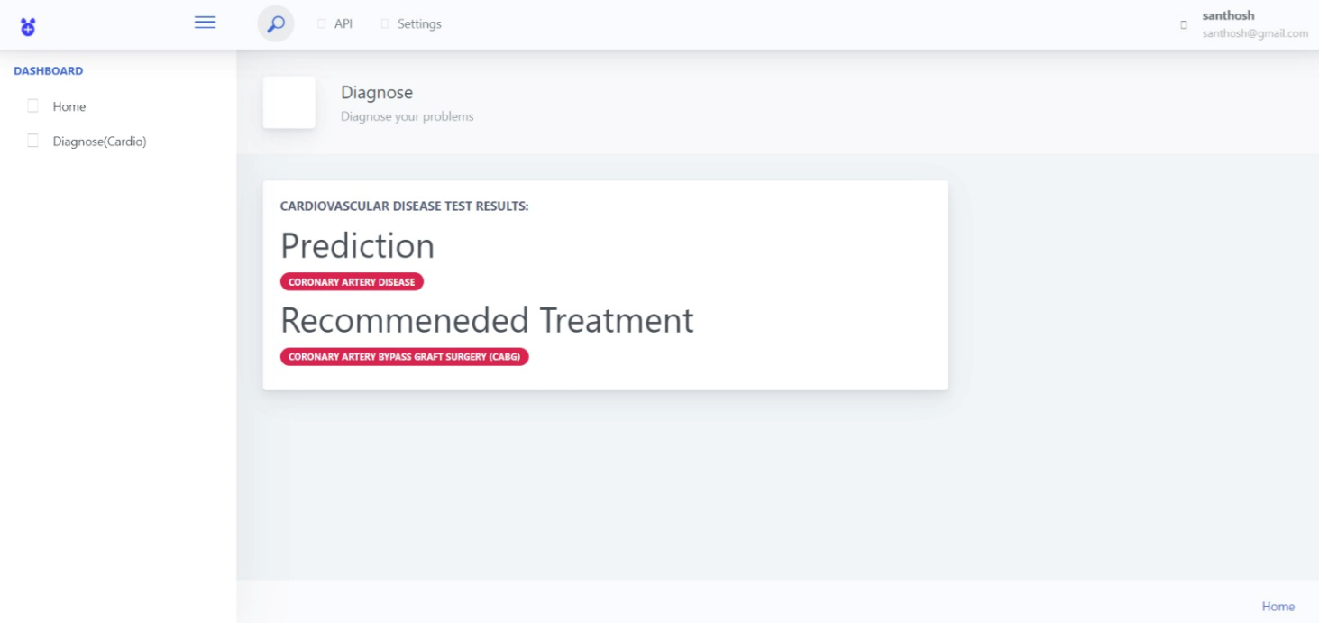
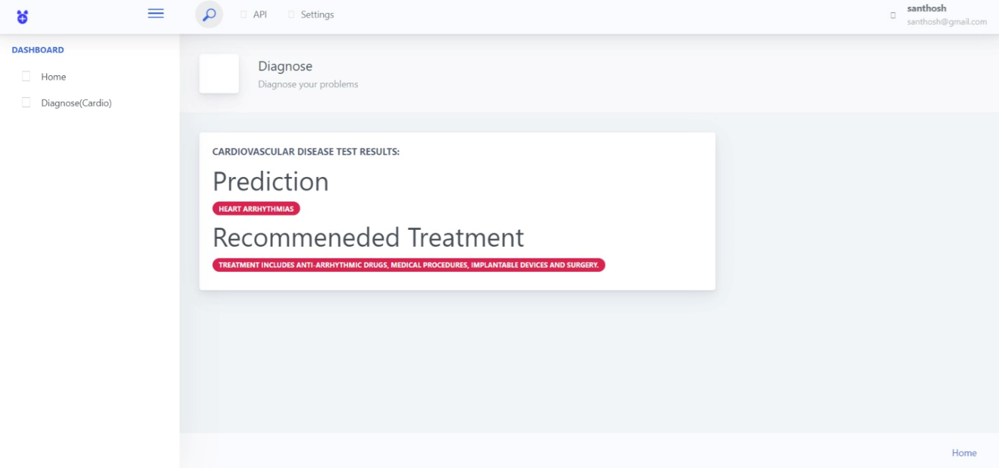
Results

Slide 32
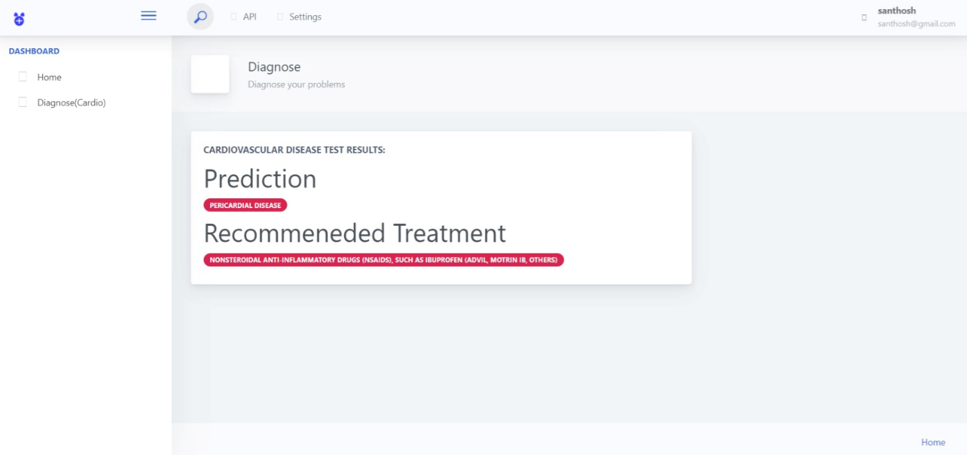
Results

Slide 33
CONCLUSION
The present study investigates the performance of seven standalone ML models and a voting classifier using the Cleveland dataset
And by using the ML models and voting classifier it predicts the HD and classifies it into different stages.

Slide 34
THANK
YOU

